Slide 1
Recursion In-order Traversal using Recursion
- Akshay Dhillon

Slide 2
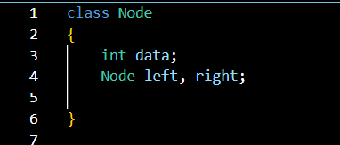
Recursion
Lets assume we have a Binary Tree:
In-order traversal:
When we visit the nodes in the following orders:
Left Node
Root Node
Right Node
In-order Traversal of this given tree would be
4 -> 2 -> 5 -> 1 -> 6 -> 3 -> 7
1
2
3
4
5
6
7

Slide 3
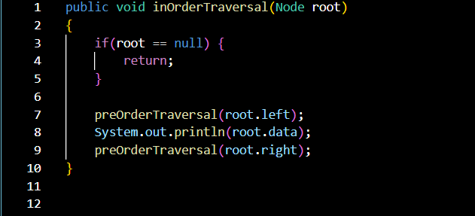
Recursion
In-order Traversal of this given tree would be
4 -> 2 -> 5 -> 1 -> 6 -> 3 -> 7
Lets assume we have a Binary Tree:
1
2
3
4
5
6
7

